Slide 1

AppInsights telemetry for Business Central Partners
“It’s as simple as 1, 2, 3”
Notes:
Photo: https://www.pexels.com/photo/brown-firewood-122588/

Slide 2
In this presentation, you will learn about…
What is Azure AppInsights?
Azure AppInsights for partners (end to end)
Setup
Discover
Visualize, monitor, and alert
Troubleshoot using telemetry
New skills needed
What signal is currently available?

Slide 3
It’s as simple as 1, 2, 3
Set up AppInsights for one or more environments
Deploy dashboards from the samples site
Monitor your environments
Notes:
High-level takeaway

Slide 4

What is Azure Monitor (AppInsights)?
Notes:
https://docs.microsoft.com/en-us/azure/azure-monitor/overview

Slide 5

Azure AppInsights for Business Central partners (end to end)
Setup
Monitor
Troubleshoot
Mitigate
Notes:
Picture: https://www.pexels.com/photo/photo-of-woodpile-1787035/

Slide 6
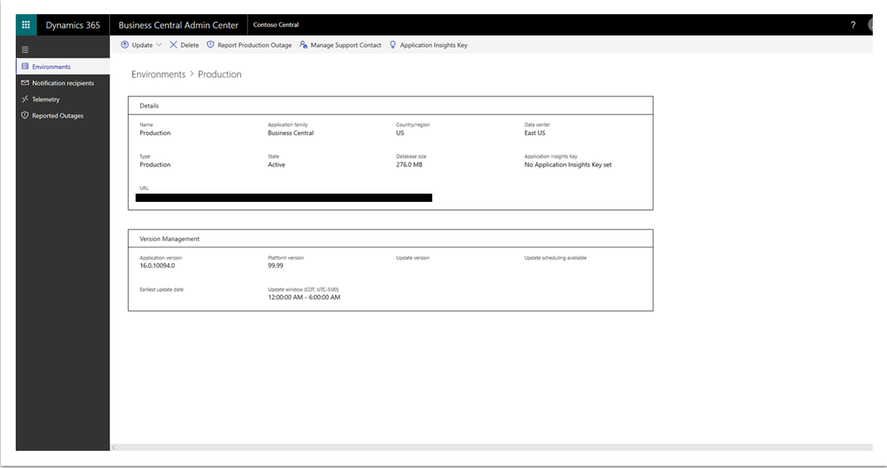
Notes:
App Insights key is per environment. This is BYO (Bring Your Own) AppInsights
See
https://docs.microsoft.com/en-us/dynamics365/business-central/dev-itpro/administration/tenant-admin-center-telemetry#sending-telemetry-to-microsoft-azure-application-insights

Slide 7
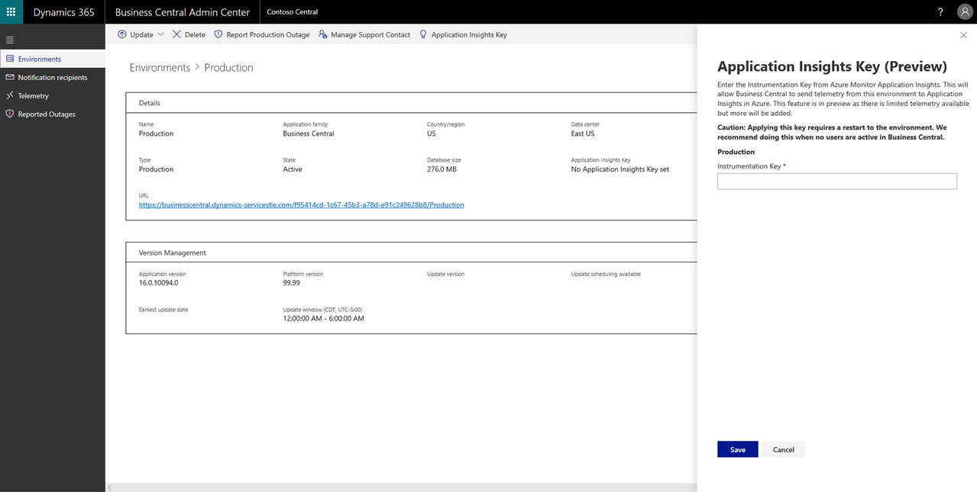
Notes:
Caution: will require a tenant environment restart. Do it off-hours (will cancel all sessions), takes 1-2 minutes to get the environment back online

Slide 8
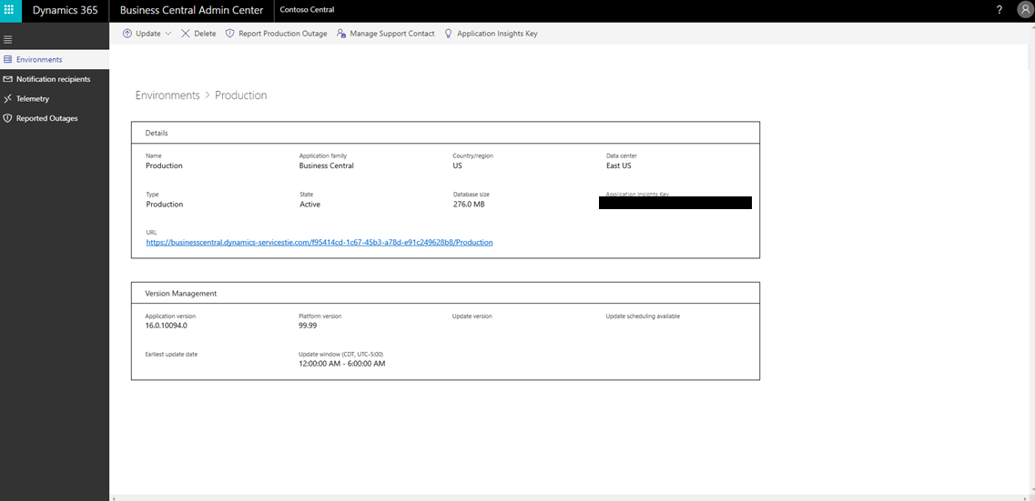
Notes:
Now the instrumentation key is registered with the application servers (NSTs)

Slide 9
Works also on-prem (was like this in 2019 release wave 2)
Use Powershell cmdlets to inject AppInsights key into the NST
Single Tenant mode (2019 release wave 2, CU1)
Set-NAVServerConfiguration
-KeyName ApplicationInsightsInstrumentationKey -KeyValue <guid>
-ApplyTo All -ServerInstance <instance name>
Multi Tenant mode
Mount-NAVTenant -AadTenantId <aad guid>
-DatabaseName <database name> -Id <tenant id>
-DisplayName <tenant name>
-ApplicationInsightsKey <guid>
Notes:
See
https://docs.microsoft.com/en-us/dynamics365/business-central/dev-itpro/administration/telemetry-enable-application-insights

Slide 10

Setup scenarios for partners
Imagine a partner managing 100 environments for 40 different customers.
One AppInsights account can be used for many environments.
E.g. One AppInsights for prod, one for sandboxes
E.g. select customers want to use their own
Notes:
Picture: https://www.pexels.com/photo/assortment-black-and-white-black-and-white-chrome-220639/

Slide 11
Characteristics of partner telemetry
Treated as an API
Discoverable in docs
Documented in docs
Actionable
(if possible)

Slide 12
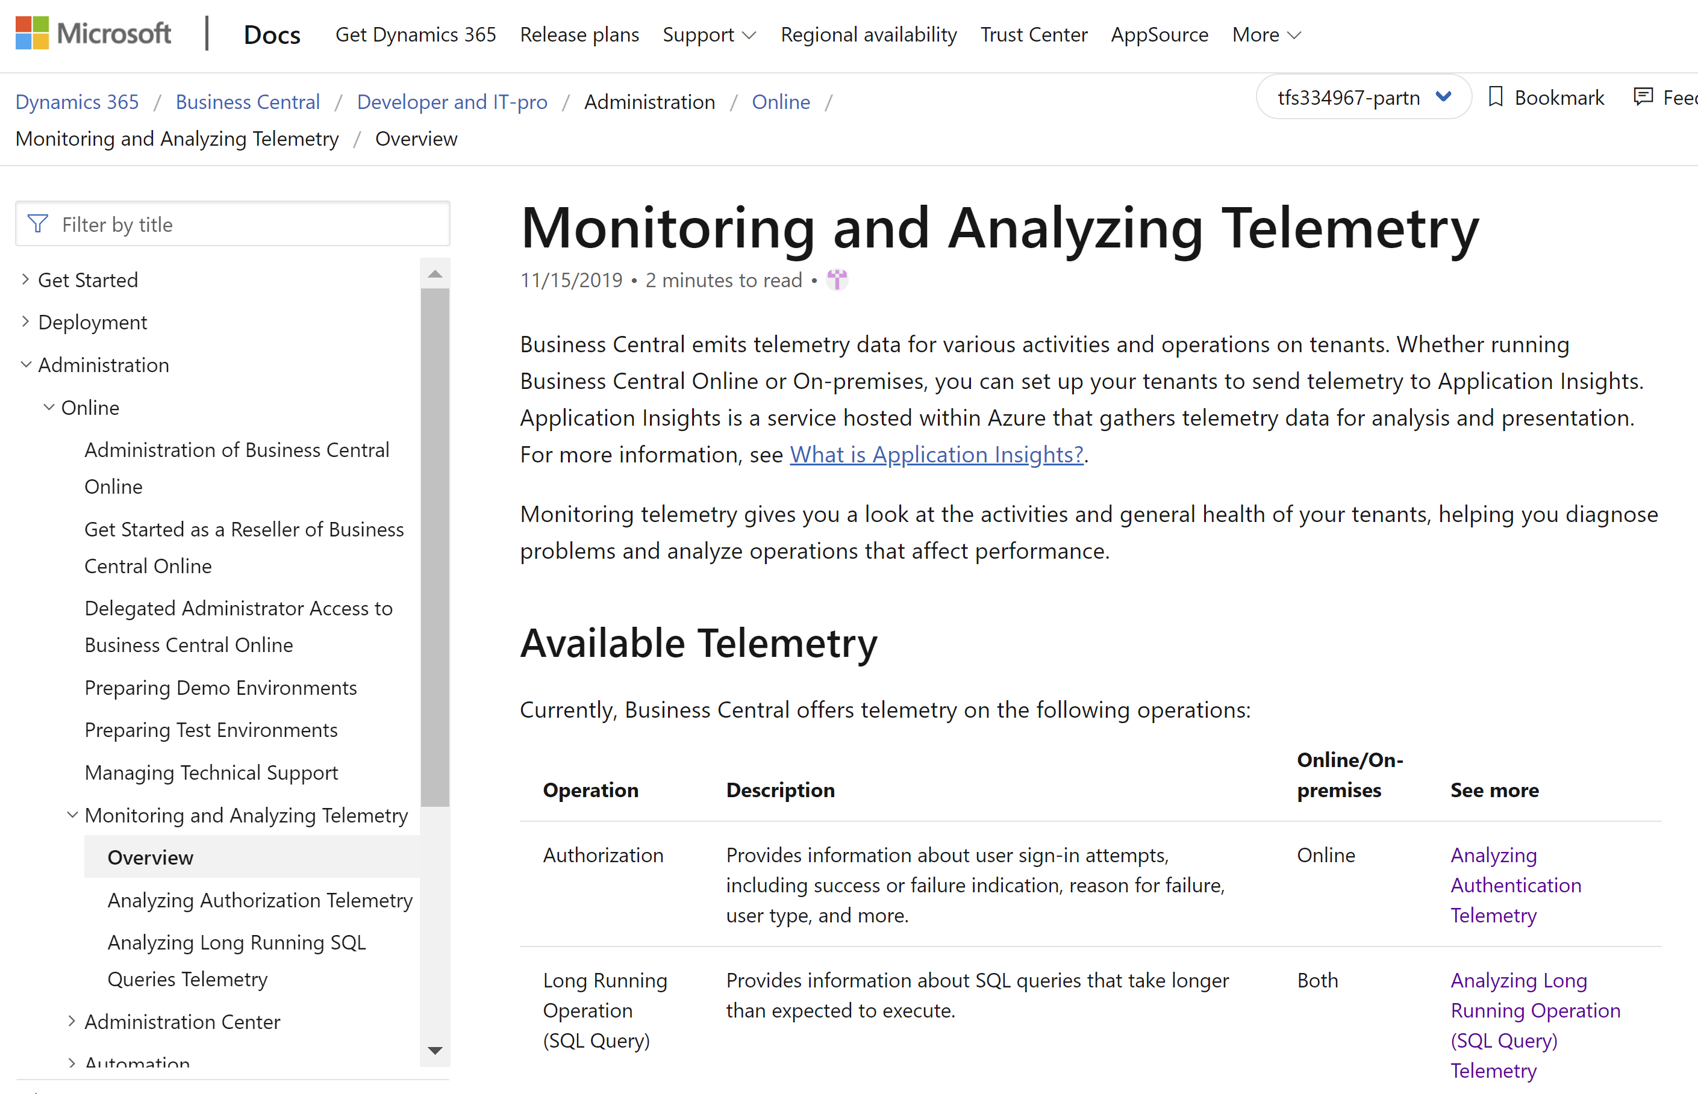
Landing page in docs
Notes:
https://docs.microsoft.com/en-us/dynamics365/business-central/dev-itpro/administration/telemetry-overview

Slide 13
How to visualize data from AppInsights
Use Azure dashboards (demo)
https://docs.microsoft.com/en-us/azure/azure-monitor/learn/tutorial-app-dashboards#add-logs-analytics-query
Use PowerBI
https://docs.microsoft.com/en-us/azure/azure-monitor/app/export-power-bi
Use Jupyter/Azure Monitor workbooks
https://docs.microsoft.com/en-us/azure/azure-monitor/app/usage-workbooks
Notes:
https://docs.microsoft.com/en-us/azure/azure-monitor/learn/tutorial-app-dashboards#add-logs-analytics-query

Slide 14
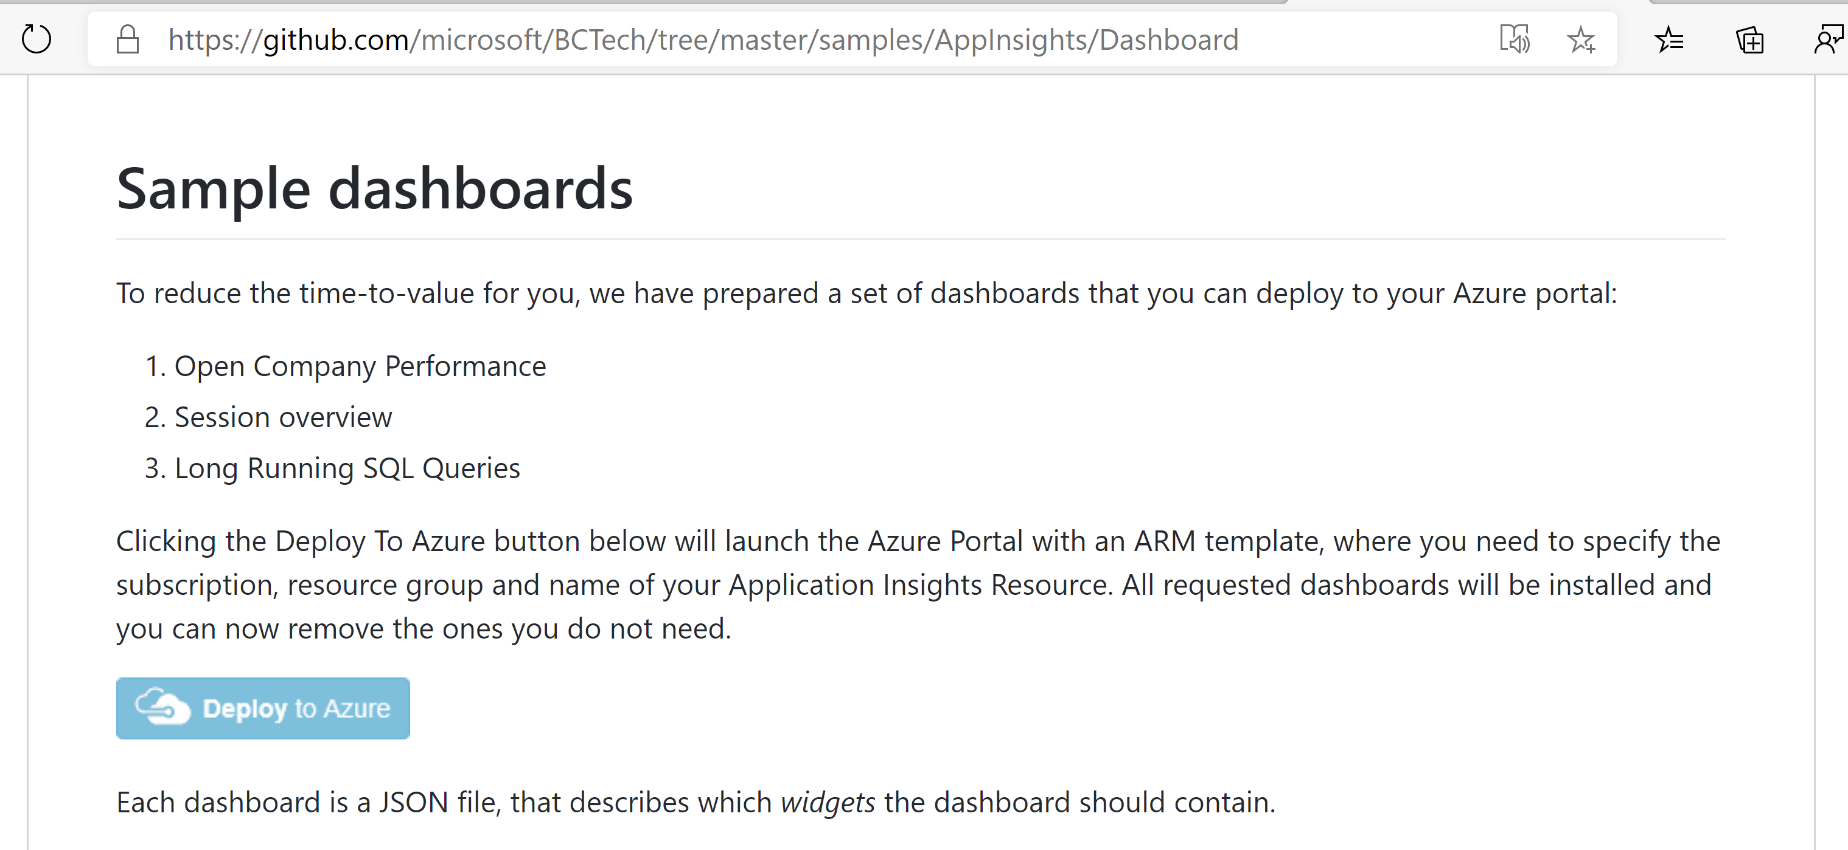
How to deploy sample dashboards
Notes:
https://github.com/microsoft/BCTech/tree/master/samples/AppInsights/Dashboard

Slide 15
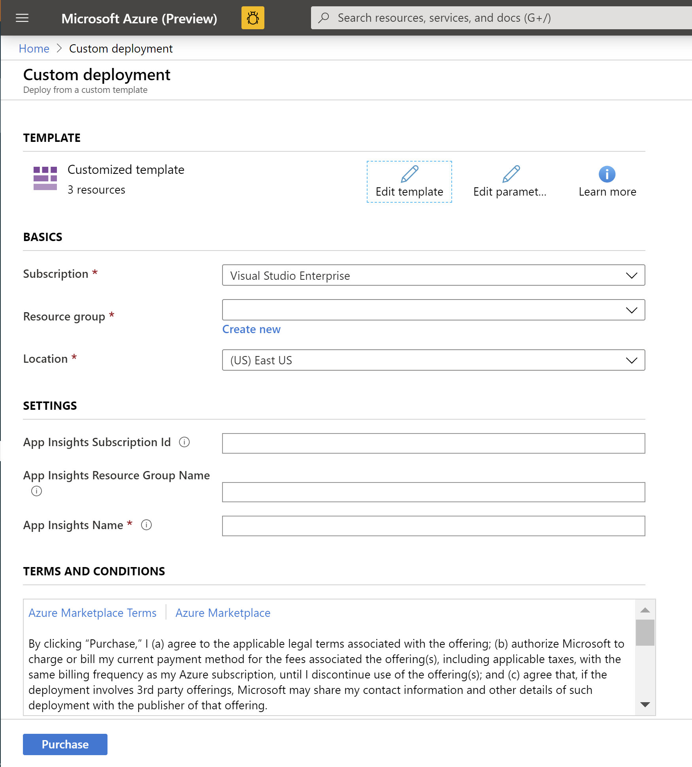
Fill in the deployment template and click “Purchase”

Slide 16
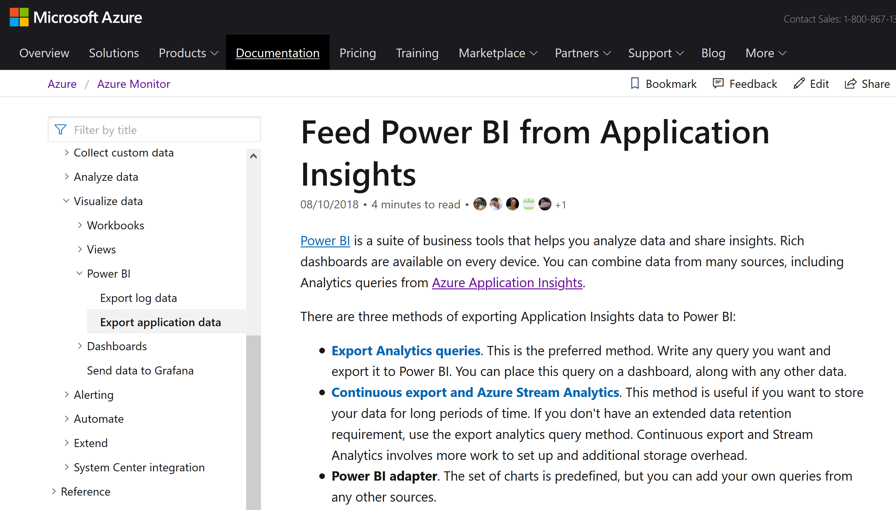
How to connect PowerBI to AppInsights
Notes:
https://docs.microsoft.com/en-us/azure/azure-monitor/app/export-power-bi

Slide 17
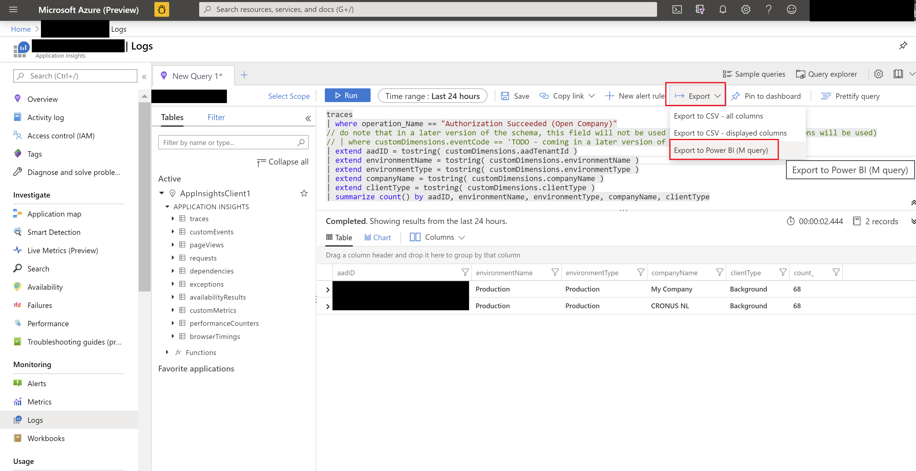
Export KQL query to M query (to be used in PowerBI)

Slide 18
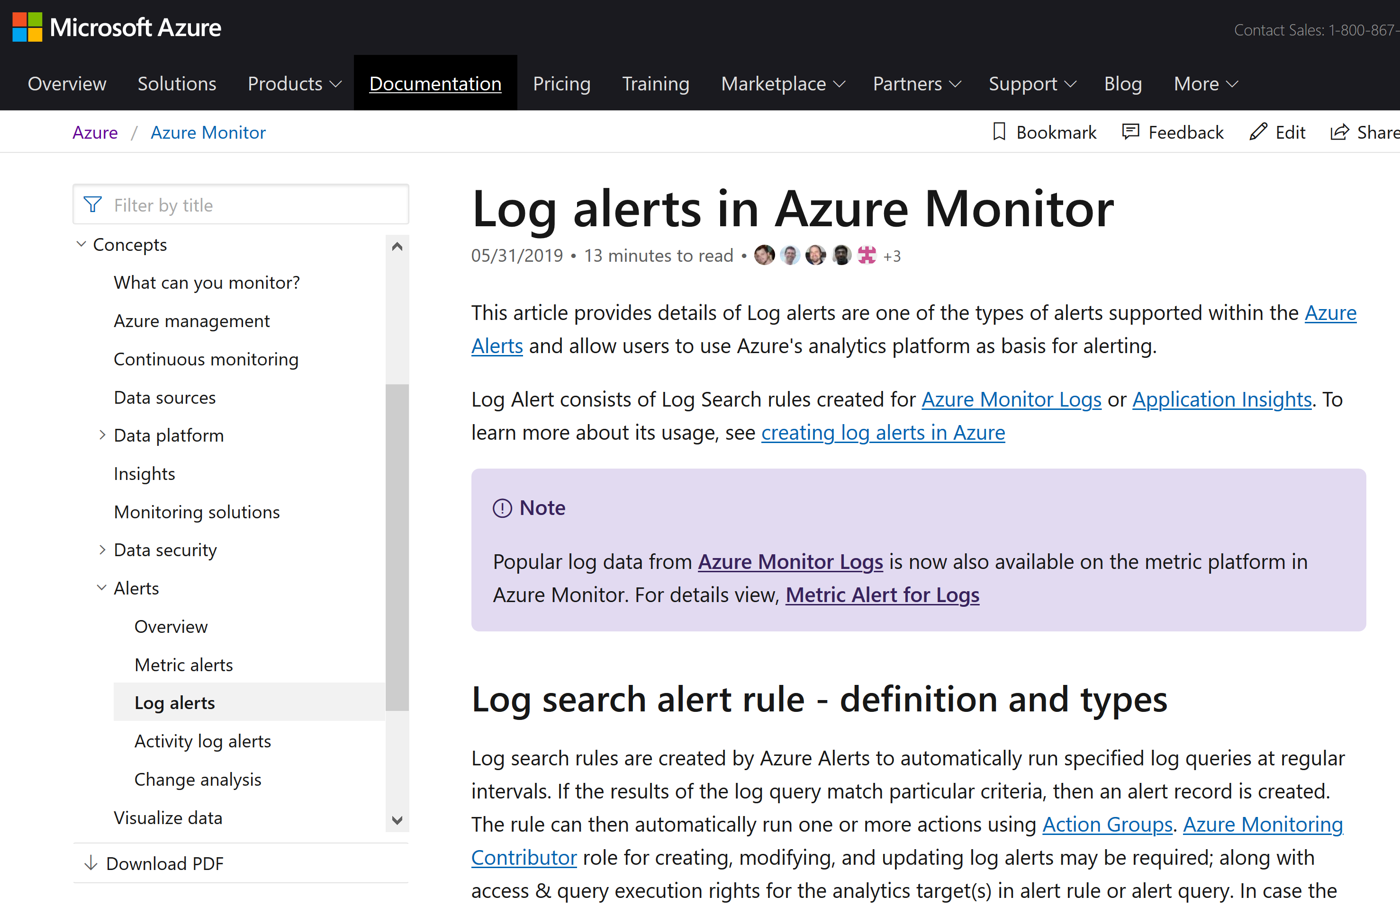
How to set up log alerts in Azure Monitor based on a Kusto query
Notes:
https://docs.microsoft.com/en-us/azure/azure-monitor/platform/alerts-unified-log

Slide 19
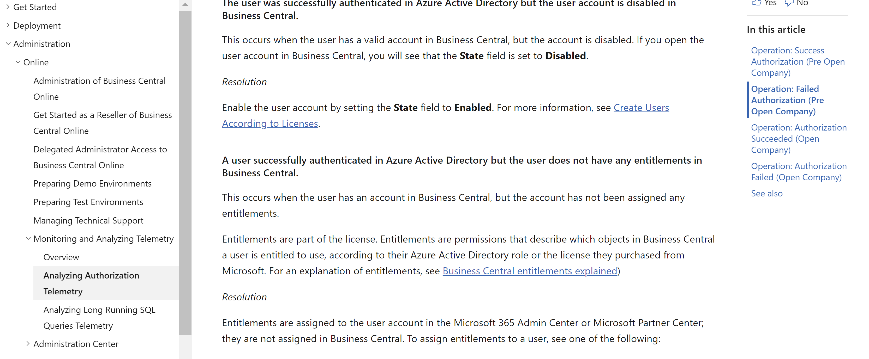
Example: Trouble Shooting Guide (TSG) on login failures (in docs)
Notes:
Authorization signal added in 15.3
https://docs.microsoft.com/en-us/dynamics365/business-central/dev-itpro/administration/telemetry-authorization-trace

Slide 20
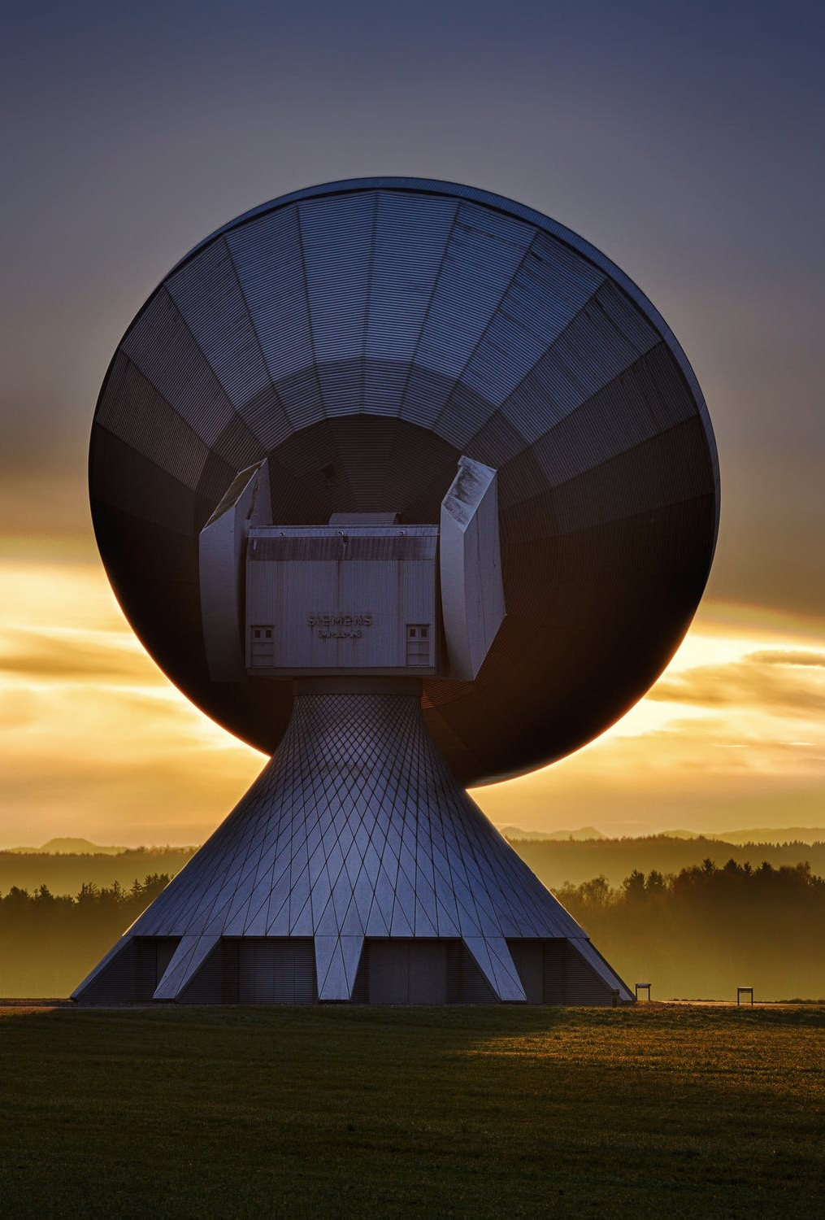
Example: What can you infer from web service signal?
Many messages where endpoint contains “powerbi” => excessive powerBI reports
If start message + long running sql query + end message => maybe need to adjust/tune codeunit
If many 429 (Too Many Requests) => adjust client consuming web service end point
If many 500 (Timeout) => Tune code unit/page
If many requests <> API type => uptake API pages to get better perf
If start message but no end message => exception raised in codeunit
Notes:
Web service signal added in 16.0
Picture: https://www.pexels.com/photo/antenna-contact-dawn-dusk-33153/

Slide 21

New skills needed for partners
Learn KQL
Learn about Azure Monitor
Think more like livesite
Get acquainted with TSGs on docs
Notes:
Picture: https://www.pexels.com/photo/man-grinding-metal-3484702/

Slide 22
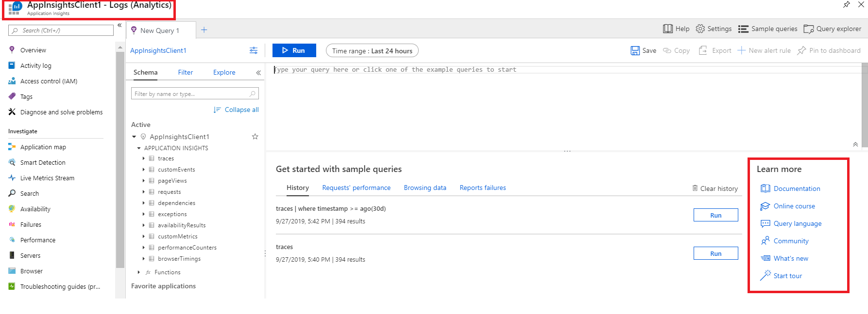
Kusto Query Language (KQL)

Slide 23
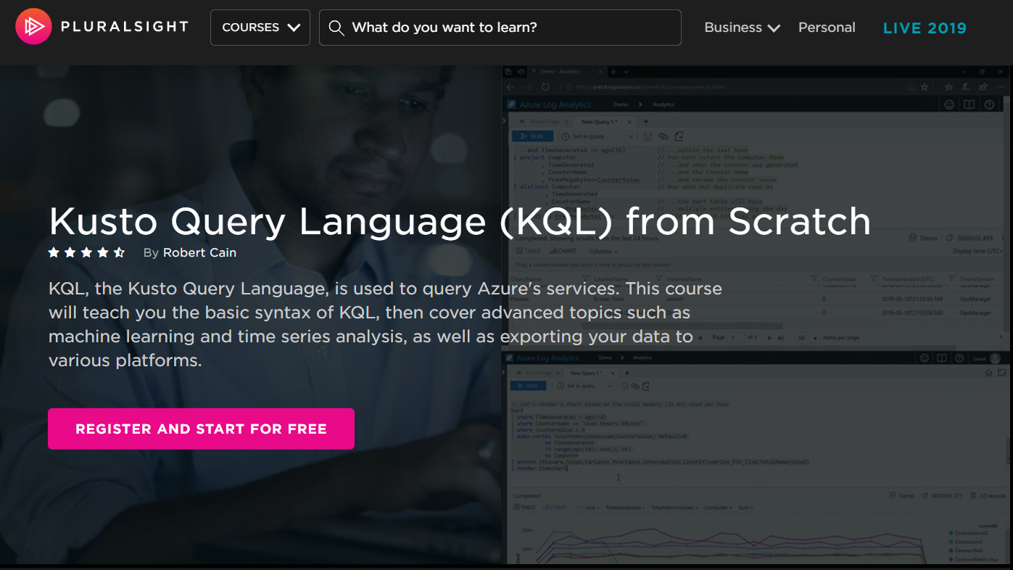
Notes:
Example query:
traces
| extend clienttype = tostring(customDimensions.['Client type'])
| where timestamp >= ago(30d)
| project timestamp, clienttype , customDimensions , AADTenantId=cloud_RoleName

Slide 24
Available signal
2019w2 rc: Long Running SQL Queries
2019w2 CU3: Authorization
2020w1 rc: web service request performance
2020w1 rc: report performance
2020w1 rc: open company performance
Notes:
See samples and schedule here: https://github.com/microsoft/BCTech/tree/master/samples/AppInsights/KQL
Docs overview: https://docs.microsoft.com/en-us/dynamics365/business-central/dev-itpro/administration/telemetry-overview
Picture:
https://www.pexels.com/photo/ocean-wave-1656579/

Slide 25
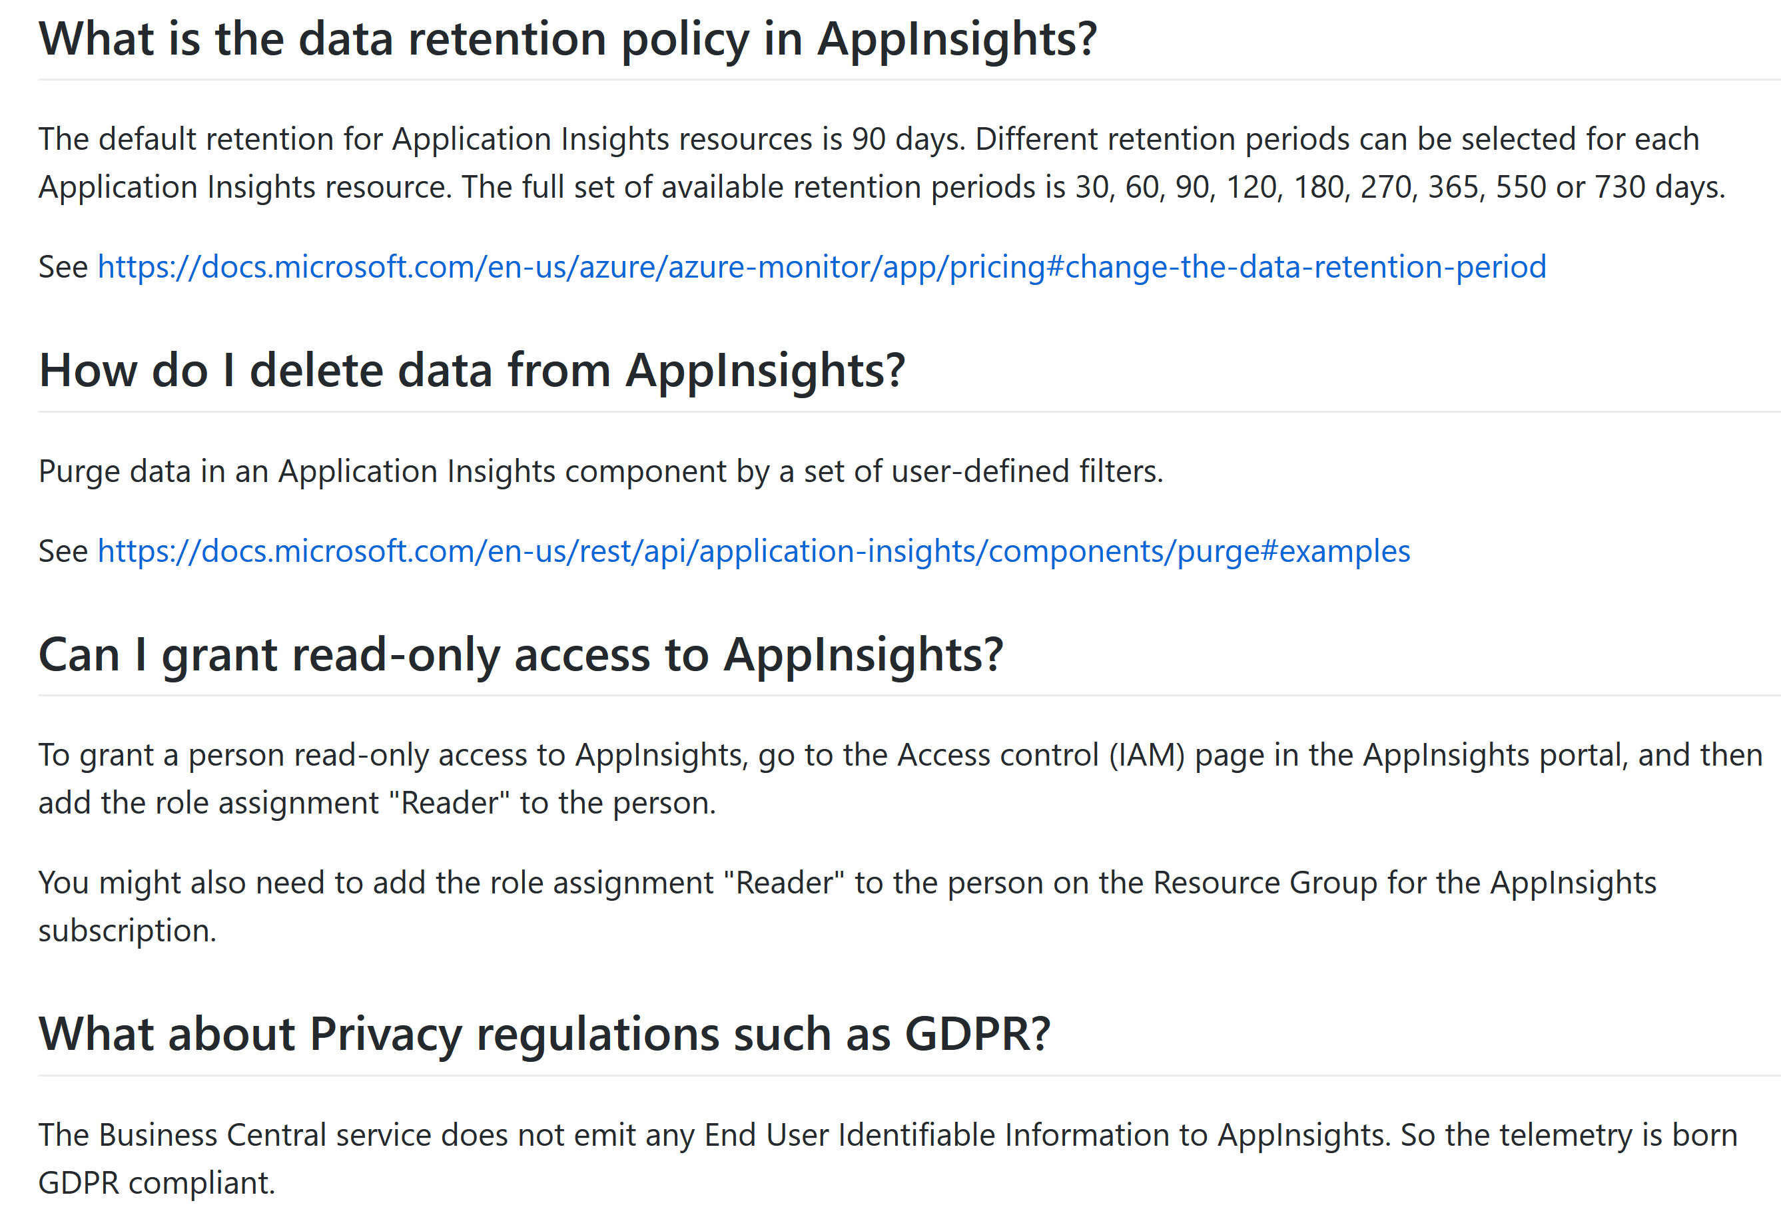
FAQ
Notes:
https://github.com/microsoft/BCTech/tree/master/samples/AppInsights#frequently-asked-questions-faq

Slide 26
Links
About Azure Monitor/AppInsights
https://docs.microsoft.com/en-us/azure/azure-monitor/app/app-insights-overview
Setup Business Central to emit telemetry to Azure AppInsights
https://docs.microsoft.com/en-us/dynamics365/business-central/dev-itpro/administration/tenant-admin-center-telemetry#sending-telemetry-to-microsoft-azure-application-insights
Telemetry signal overview
https://docs.microsoft.com/en-us/dynamics365/business-central/dev-itpro/administration/telemetry-overview
Samples
https://github.com/microsoft/BCTech/tree/master/samples/AppInsights

